Slide 1

OIL WELL MONITORING SYSTEM
Presented By:-
Louis Bengtson
Kaleb Stunkard
Jimit Shah

Slide 2
MOTIVATION
More than 27,000 oil wells permanently abandoned in the Gulf of Mexico.
Currently, there is no monitoring system available.
Four teams:
Buoy Team (Mechanical Engineering)
Bi-directional Turbine Team (Mechanical Engineering)
Sensor Team (Mechanical Engineering)
Electrical Team (Electrical Engineering)

Slide 3
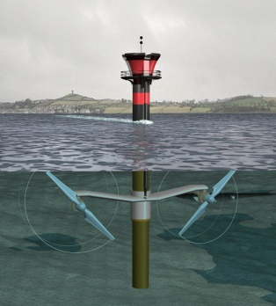
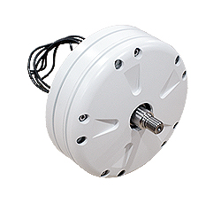
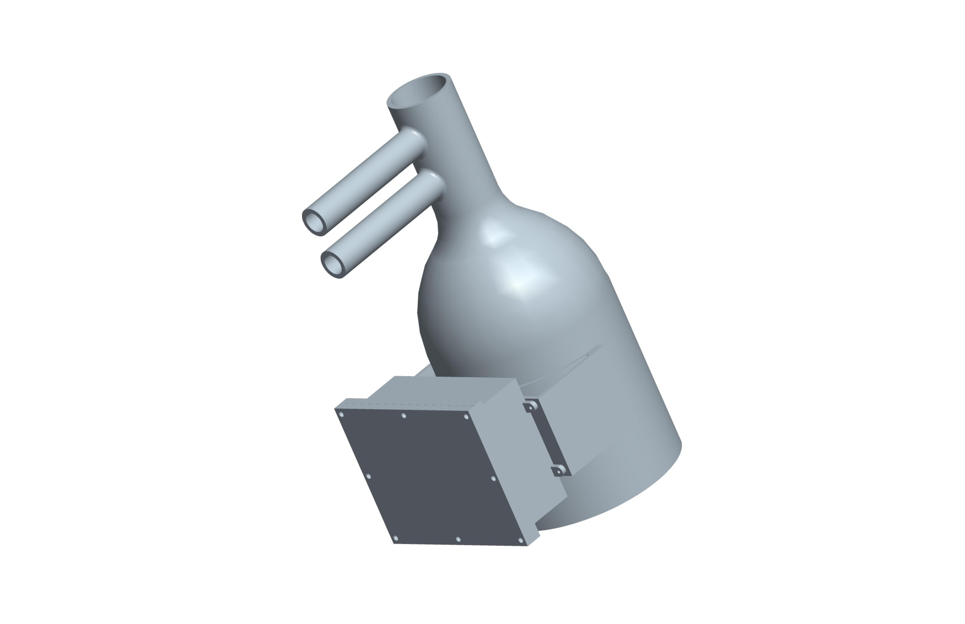
Turbine
Ginlong Generator
System Block Diagram
INPUT CIRCUIT
CONTROL
PROCESSOR
BUCK CONVERTER
Sensor
BATTERY CHARGING CIRCUIT
Electrical System

Slide 4
OBJECTIVES
Efficiently convert varying AC voltage to steady DC voltage.
Be able to charge a battery that will supply the necessary output voltage to the sensors.
Must be self powered.
Components must be placed in an enclosure to be mounted on the buoy.
Must be able to work in high and low pressure environment.
Must be suitable for dry and wet conditions.

Slide 5
SPECIFICATIONS
Input RPM range: 90 to 125 RPM
Input Voltage range: 0VAC to 60VAC
Output Current: 1A
Output Voltage: 12VDC
Cost: Less than $2,000
Efficiency: 85%
Operating Environments
Temperature: 25 to 110°F
Humidity: 100%

Slide 6
Input Circuit
- Kaleb Stunkard

Slide 7
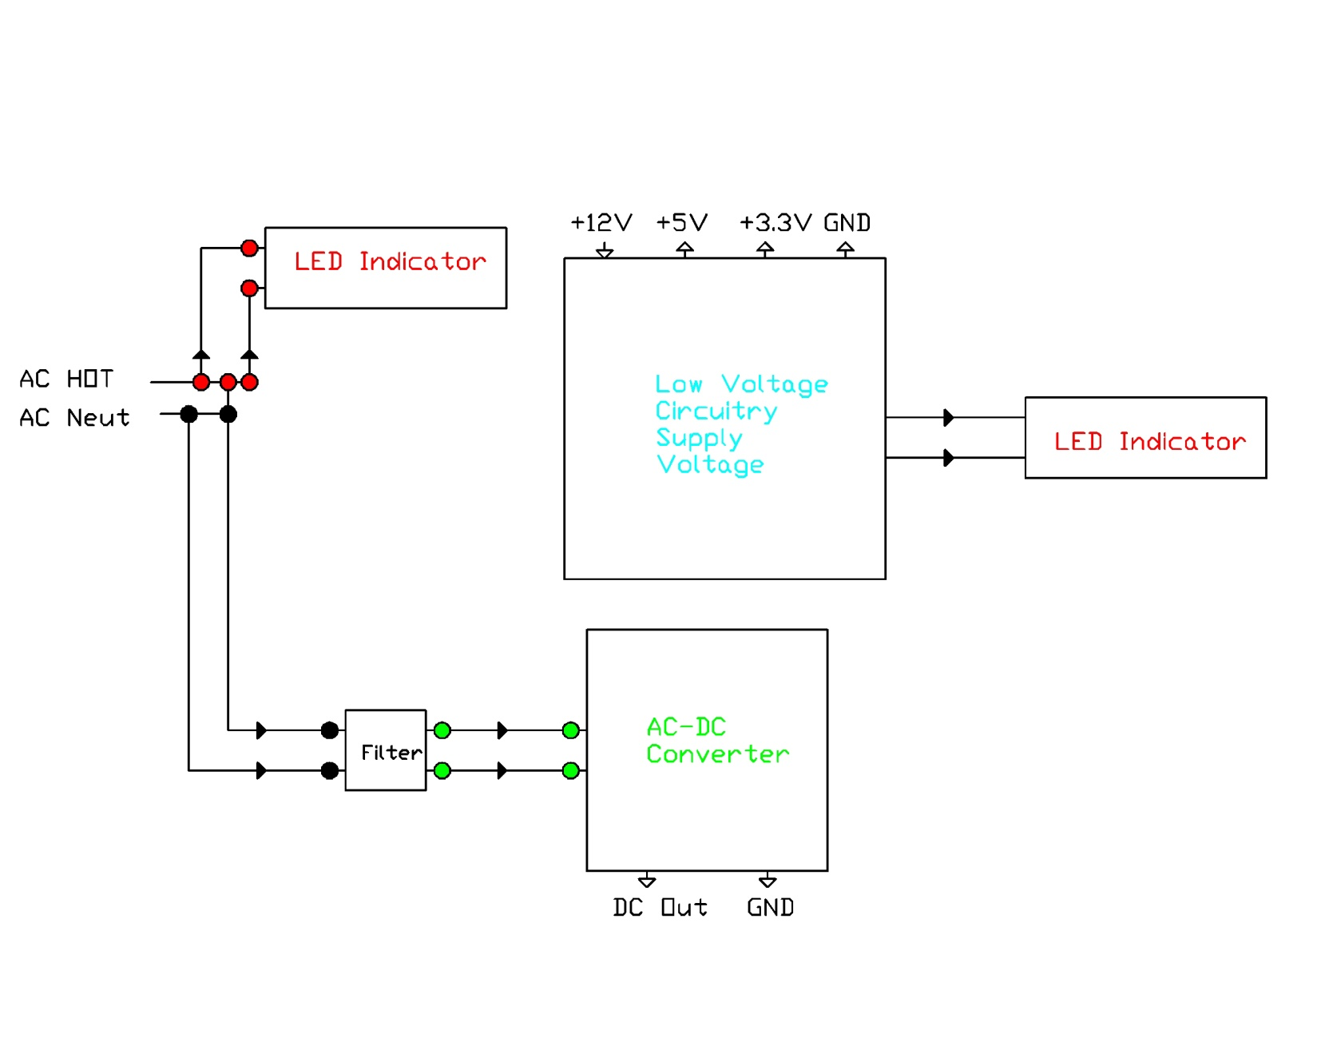
Input Power Block Diagram

Slide 8
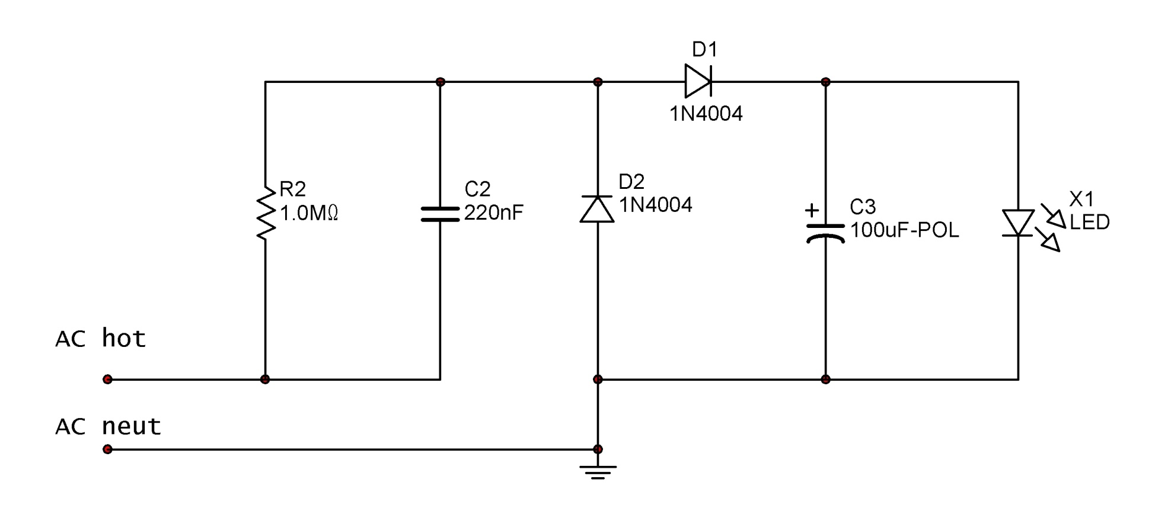
LED Indicator Schematic

Slide 9
Input Power Block Diagram

Slide 10
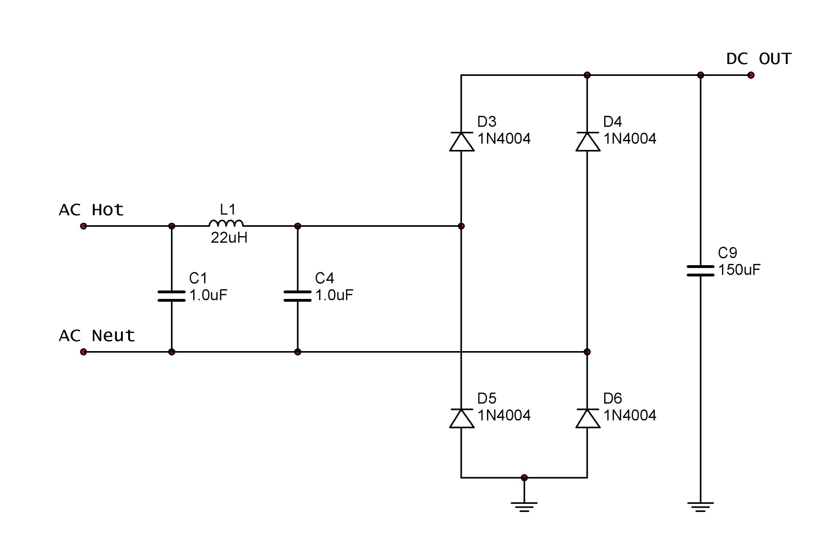
AC-DC Converter Schematic

Slide 11
Input Power Block Diagram

Slide 12
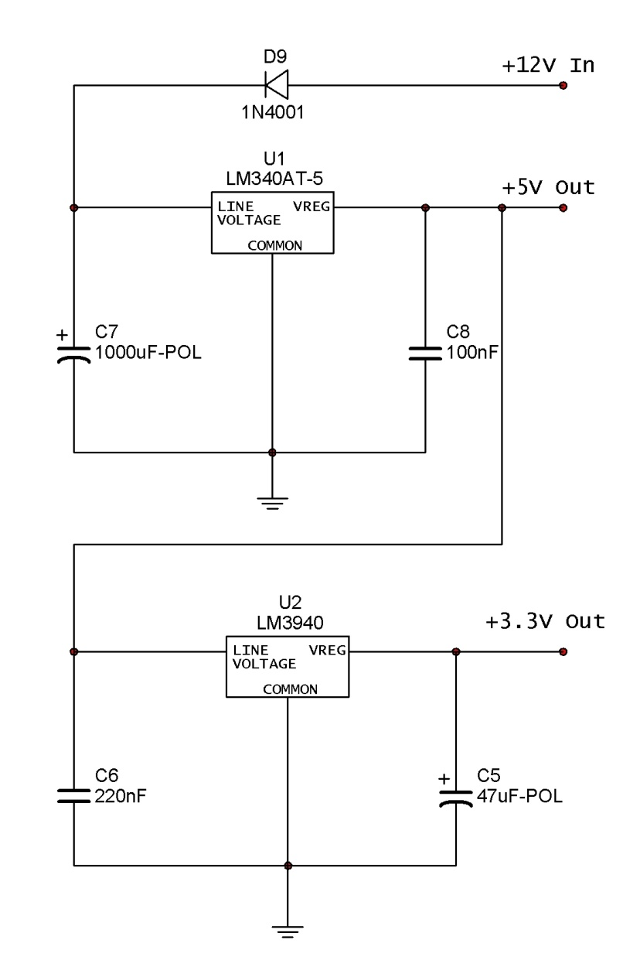
Low Voltage Circuitry Supply Schematic

Slide 13
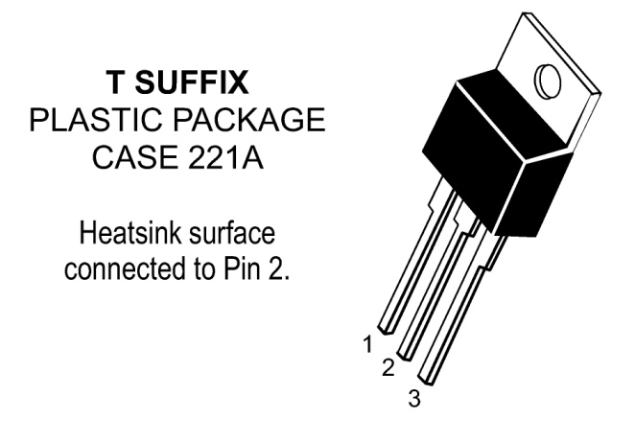
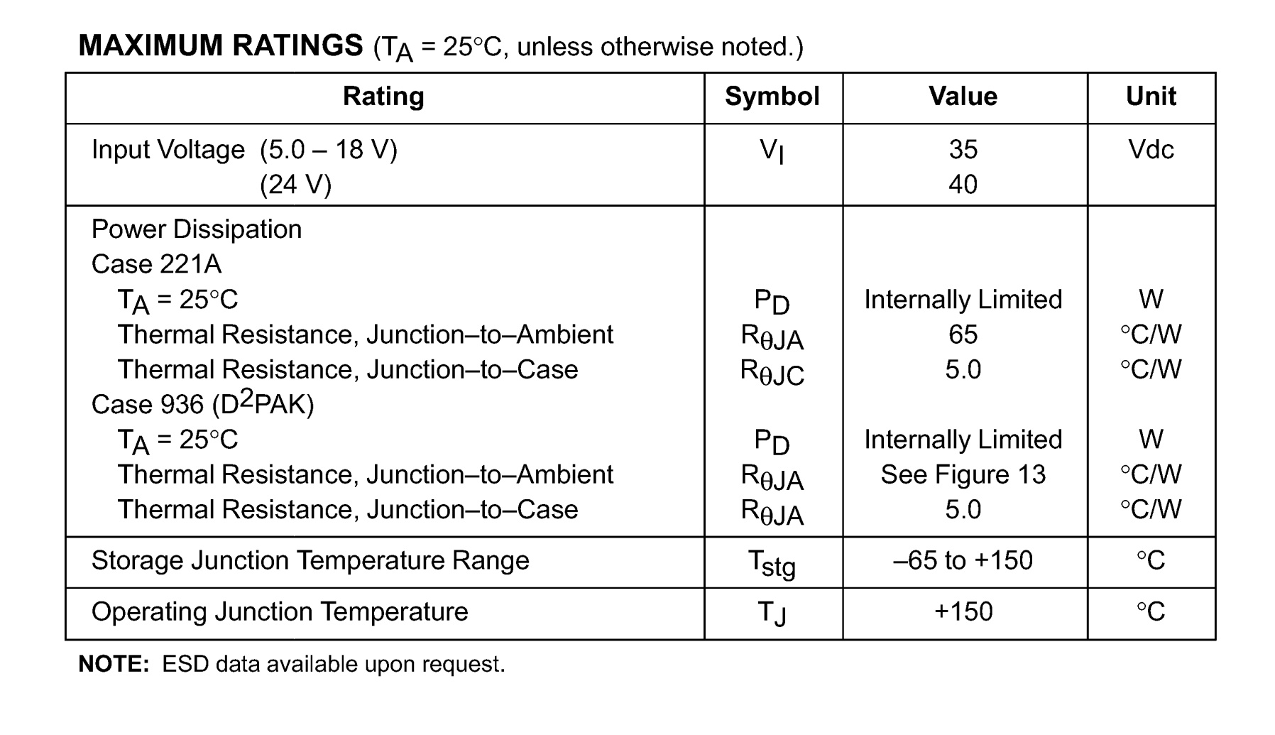
LM340AT – 5

Slide 14
Low Voltage Circuitry Supply Schematic

Slide 15
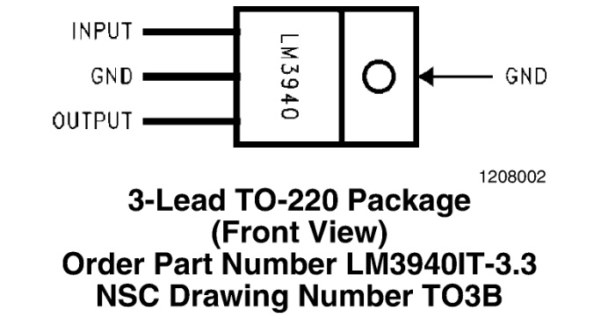
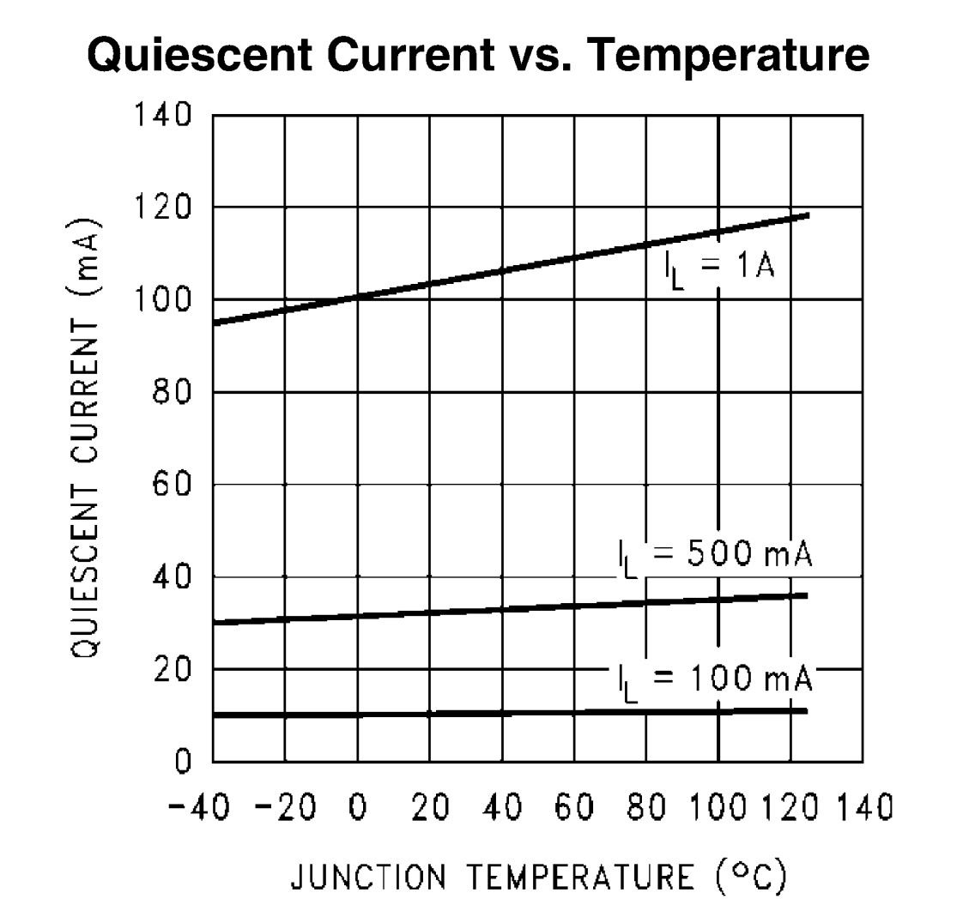
LM3940

Slide 16
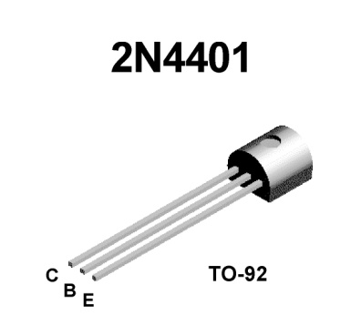
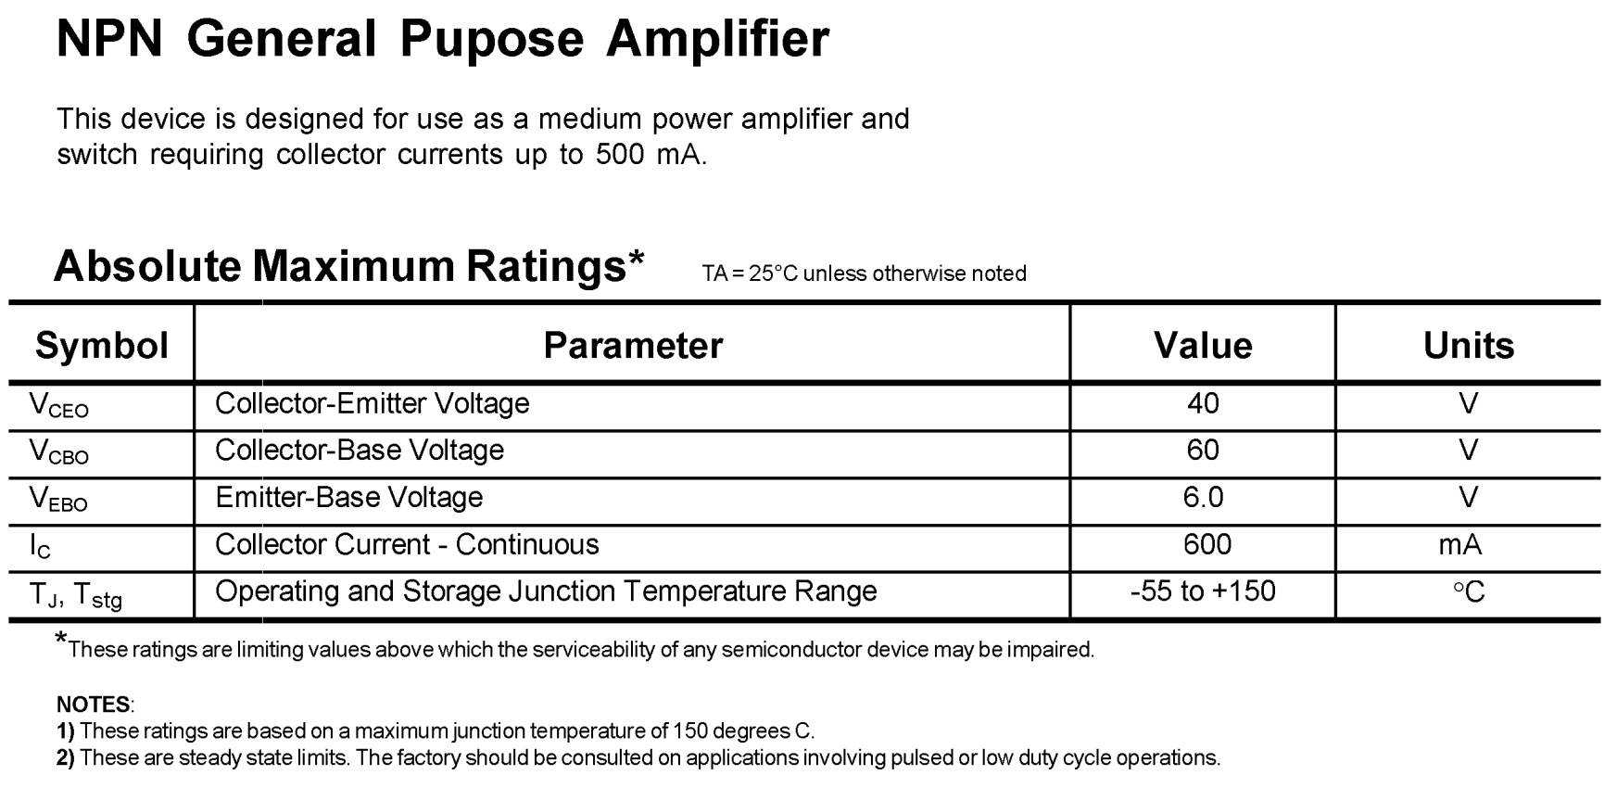
2N4401

Slide 17
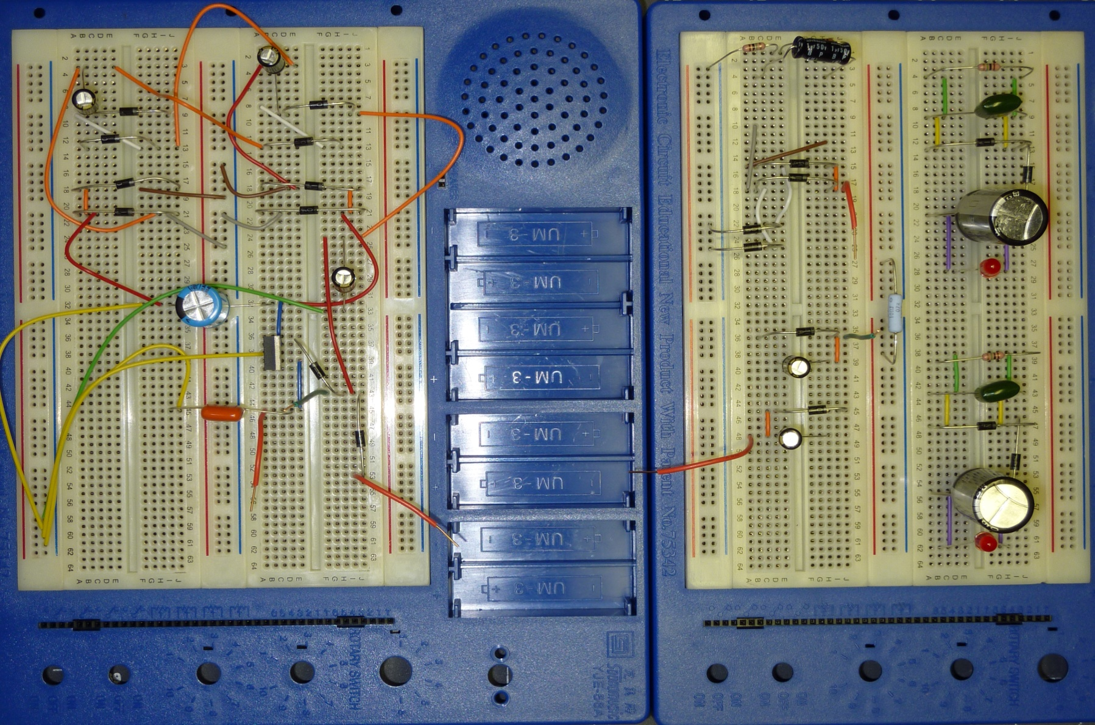
Input Power Prototype

Slide 18
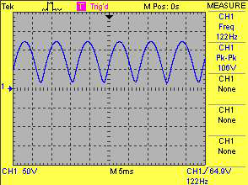
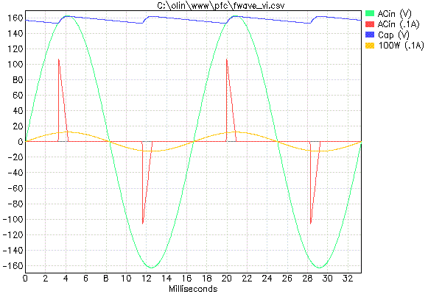
Results

Slide 19
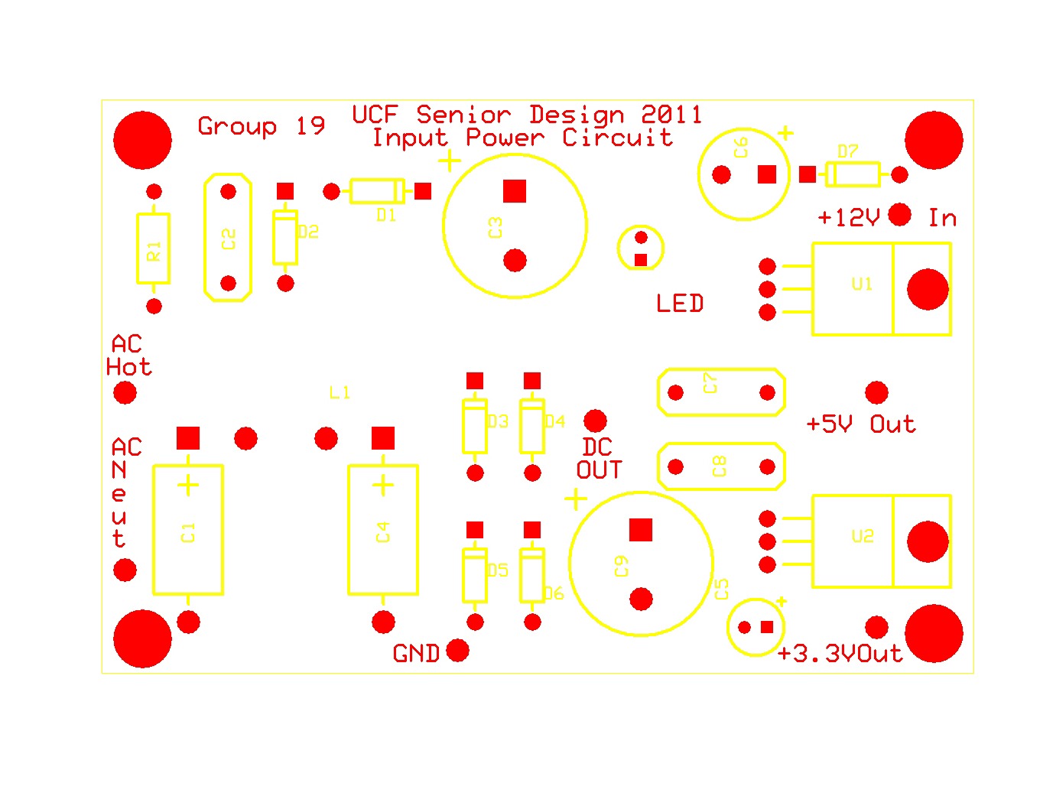
PCB

Slide 20
BUCK CONVERTER & BATTERY CHARGING CIRCUIT
- Jimit Shah

Slide 21
Block Diagram
DC Signal
BUCK
CONVERTER
0 - 60 V
15.6 V
BATTERY CHARGER
13.8V
BATTERY
SENSORS
Input
Output

Slide 22
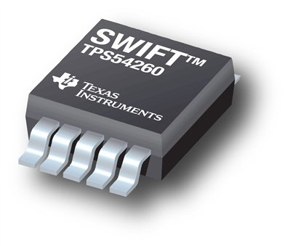
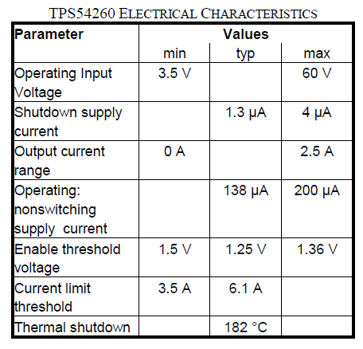
Buck Converter: TPS54260 – Step Down Converter
Wide Input Range
3.5V to 60V
High Output Current
0A to 2.5A
Enable Pin
Fixed Output Voltage
EVM available

Slide 23
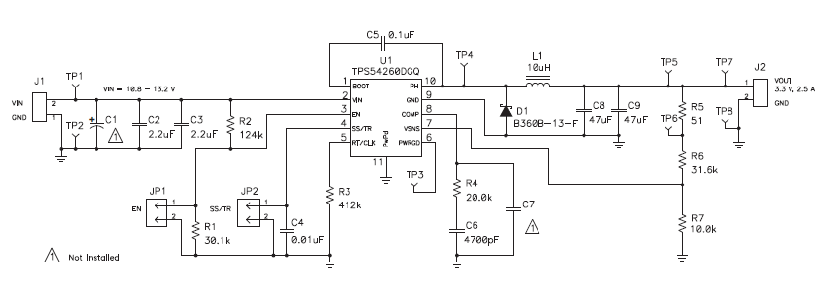
TPS54260EVM Schematic
Replaced Components: R6, C8, and C9

Slide 24
Battery Charger: BQ24450 – Integrated Charge Controller
Designed for Lead Acid Batteries.
Voltage and Current Regulation.
Optimization and maximization of battery capacity over temperature.
Ensure battery safety for charging at high temperature.
EVM available

Slide 25
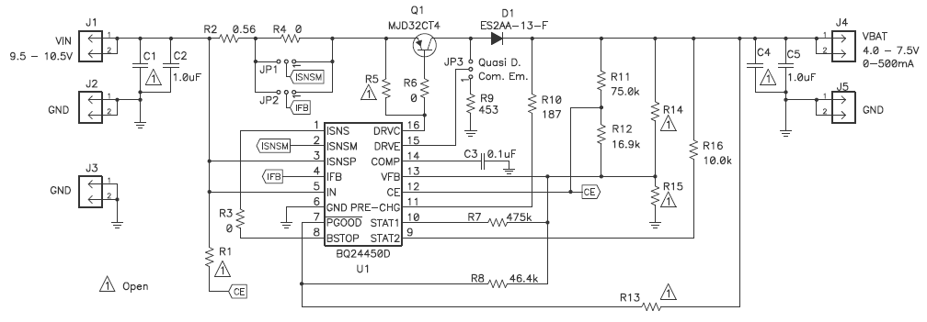
BQ24450EVM Schematic
Replaced Components: R7, and R11

Slide 26
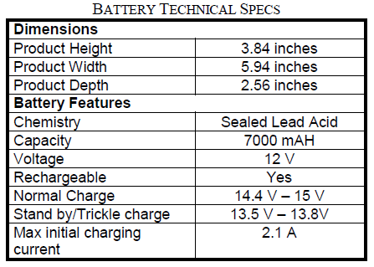
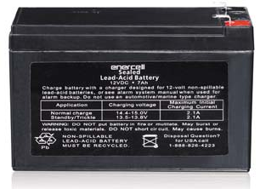
Battery: Enercell 12VDC 7AH Sealed Lead-Acid Battery

Slide 27
Microcontroller
- Louis Bengtson

Slide 28
Advantages of PIC Microcontrollers
PIC24FJ96GA010
Extensive available parameters
Inexpensive
Programmable in C
Compatibility with development tools
Prospect of future improvements with reprogramming

Slide 29
PIC24FJ96GA010 Specifications
Parameters | Values
Program Memory Type | Flash
Program Memory (KB) | 96
CPU Speed (MIPS) | 16
RAM Bytes | 8192
Internal Oscillator | 8 MHz, 32 kHz
nanoWatt Features | Fast Wake/Fast Control
Capture/Compare/PWM Peripherals | 5/5
Digital Communication Peripherals | 2-UART, 2-SPI, 2-I2C
Analog Peripherals | 1-A/D 16x10-bit @ 500(ksps)
Timers | 5 x 16-bit
16-bit PWM resolutions | 16
Temperature Range (deg C) | -40 to 85
Operating Voltage Range (V) | 2.5 to 3.6
I/O Pins | 85
Pin Count | 100
Volume Pricing | $3.42

Slide 30
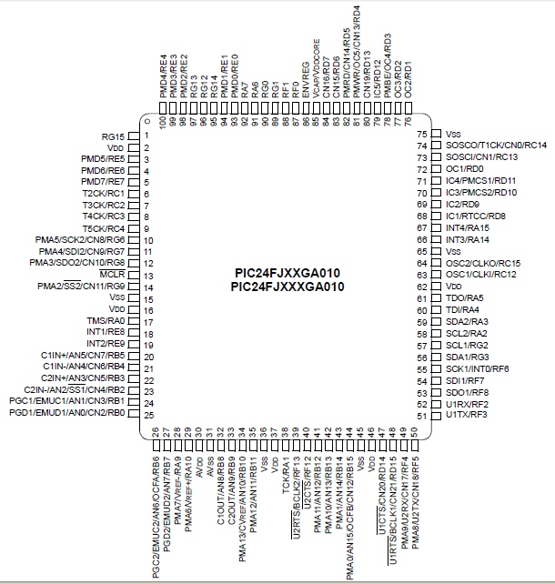

Slide 31
Microcontroller Functions
Measure input voltage and battery voltage
Display voltage readings to LCD screen
Control the enable switch on the TPS54260EVM-597 DC-DC buck converter for hysteresis and over-voltage protection

Slide 32
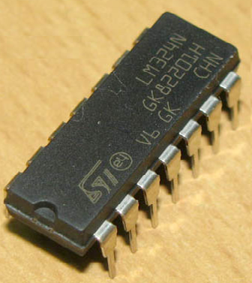
Voltage Scaling
Input and Battery voltage were scaled down by voltage dividers.
Initially voltage divider produced loading effects at higher voltages.
LM324N op-amp was used as a unity gain buffer to prevent current feeding into microcontroller.

Slide 33
C Programming Language Code
void main() {
ADPCFG = 0xFFFF; // Configure AN pins as digital I/O
TRISA = 0; // Initialize PORTA as output
LATA = 1; // Set PORTA to one
LCD_Init();
LCD_Cmd(_LCD_CURSOR_OFF); // LCD (cursor off)
LCD_Cmd(_LCD_CLEAR); // Clear LCD
text = "V in: "; // assign text to string
text2 = "Batt V: ";
while (1) {
adc_rd = ADC1_read(10); // get ADC value – Input voltage
adc_rd2 = ADC1_read(11); // get ADC value – Battery voltage
LCD_Out(1,1,text); // print on LCD, row 1, collumn 1
LCD_Out(2,1,text2); // print on LCD, row 2, collumn 1
ch3 = 0;
ch4 = 0;
for(i=0;i<500;i++)
{
tlong = (long)adc_rd * 5000; // convert adc reading to mV
tlong = (tlong / 1023); // 2^10 -> 0-5000mV
ch = (tlong / 767); // extract 10 volts digit
LCD_Chr(1,7,48+ch); // write ASCII digit at row1, collumn 7
ch = (tlong / 77) % 10; // extract volts digit
LCD_Chr_CP(48+ch); // write ASCII digit at cursor point
LCD_Chr_CP('.');
ch = (tlong / 8) % 10; // extract 0.1 volts digit
LCD_Chr_CP(48+ch); // write ASCII digit at cursor point
LCD_Chr_CP('V');
LCD_Chr_CP(' ');
LCD_Chr_CP(' ');

Slide 34
C Programming Language Code Continued
tlong2 = (long)adc_rd2 * 5000; // convert adc reading to mV
tlong2 = tlong2 / 1023; // 2^10 -> 0-5000mV
ch2 = tlong2 / 3800; // extract 10 volts digit
LCD_Chr(2,9,48+ch2); // write ASCII digit row 2, collumn 9
ch2 = (tlong2 / 380) % 10; // extract volts digit
LCD_Chr_CP(48+ch2); // write ASCII digit at cursor point
LCD_Chr_CP('.');
ch2 = (tlong2 / 38) % 10; // extract 0.1 volts digit
LCD_Chr_CP(48+ch2); // write ASCII digit at cursor point
LCD_Chr_CP('V');
ch = (tlong / 800); // 10 volts digit
ch3 = ch3 + ch;
ch2 = (tlong / 80) % 10; // Volts digit
ch4 = ch4 + ch2;
Delay_ms(2);
}
// HYSTERESIS
ch3 = (ch3 / 500); // Average 10 volts digit after 0.5 seconds
ch4 = (ch4 / 500); // Average volts digit after 0.5 seconds
if((ch3 == 5 && ch4 >= 5) || ch3 > 5)
LATA = 0; // Disable the Buck over 55V
if((ch3 == 1 && ch4 <= 5) || ch3 < 1)
LATA = 0; // Disable the Buck under 15V
if((ch3 == 2 && ch4 >= 5) || (ch3 > 2 && ch3 < 5))
LATA = 1; // Enable the Buck between 25V and 50V
}
}

Slide 35
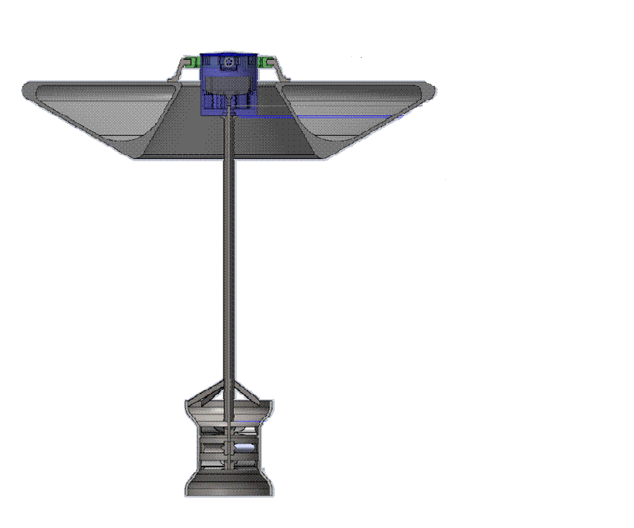
Electrical Unit
Buoy
Turbine

Slide 36
Future Developments
GPS
Use of Sepic topology instead of Buck topology
Power Factor Correction
Code Optimization

Slide 37
BUDGET
Item Description | Cost | % of Total Project Cost
Resistors | $ 5.56 | 0.39%
Capiators | $ 41.34 | 2.87%
Inductors | $ 31.92 | 2.22%
Diodes | $ 12.51 | 0.87%
Transistors | $ 15.35 | 1.07%
LEDs | $ 2.98 | 0.21%
Lead Acid Battery | $ 18.06 | 1.26%
Buck Converter EVM | $ 25.00 | 1.74%
Battery Controller EVM | $ 49.00 | 3.41%
Microcontroller | $ 3.42 | 0.24%
Blank MCU Cards | $ 56.60 | 3.93%
Breadboards | $ 64.89 | 4.51%
Breadboard Jumper Kits | $ 38.82 | 2.70%
PCB | $262.00 | 18.21%
Development Kit | $ 467.00 | 32.45%
Multimeter | $ 24.50 | 1.70%
Shipping Cost | $320.00 | 22.24%
 | $1,438.95

Slide 38
QUESTIONS?

